Slide 1
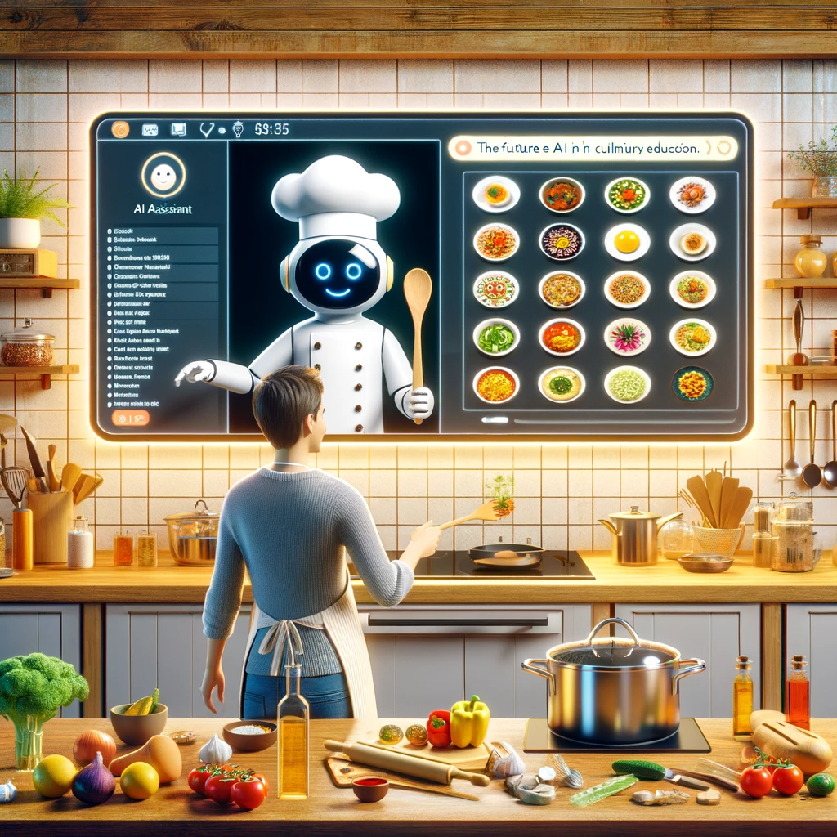
Smart Recipe Finder
Sepideh Forouzi (101599207)
George Brown College

Slide 2
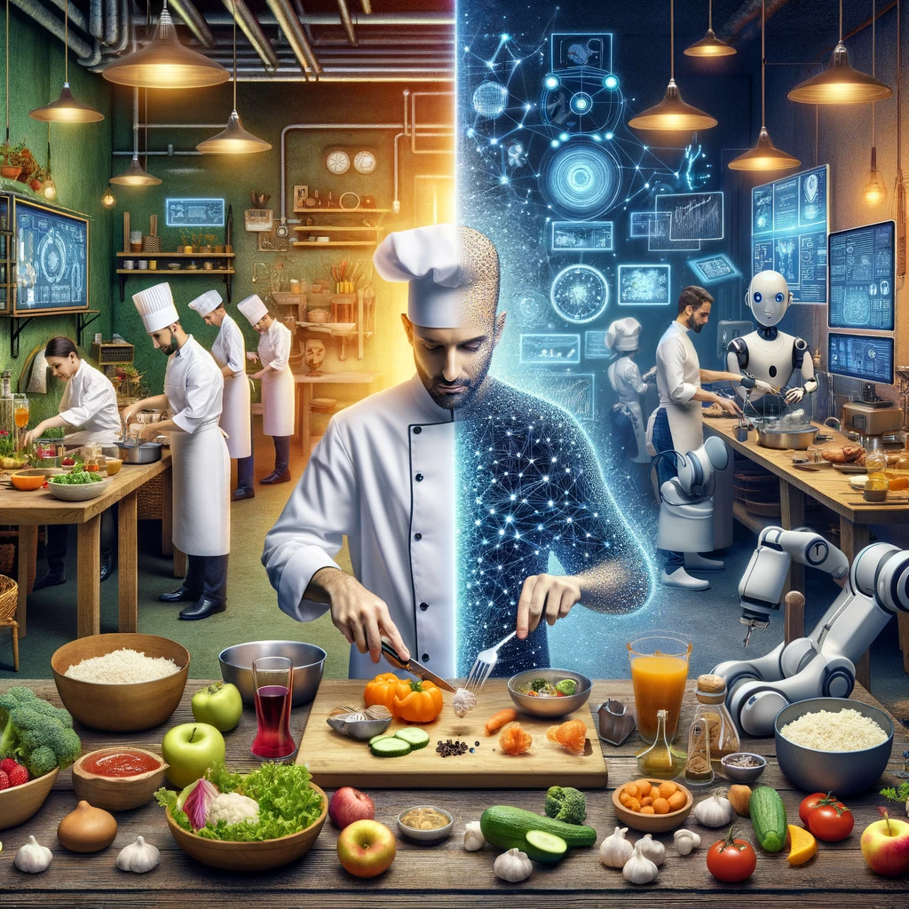
Introduction
Goal: Build an intelligent recipe-classification and generation system
Dataset: Kaggle “Food Ingredients and Recipes”, 508 unique ingredients, ~43,000 recipes
Task: Predict cuisine type based on ingredients
ML Model: TF–IDF vectorizer + Logistic Regression classifier
Deployment: Convert notebook to script → Docker container → Google Cloud Run
Outcome: A scalable, real-time web application

Slide 3

Why the Problem Is Significant
Helps reduce food waste by suggesting
recipes based on available ingredients.
Saves user time and increases convenience.
Supports healthier cooking choices by showing alternative options.
Enhances personalization in recipe recommendation systems.

Slide 4

Problem Statement
Online cooking platforms contain millions of recipes.
Users often struggle to identify recipes based on the ingredients they already have.
Searching manually is slow, inefficient, and often irrelevant.
We need an automated system that understands ingredients and predicts the correct cuisine category.

Slide 5
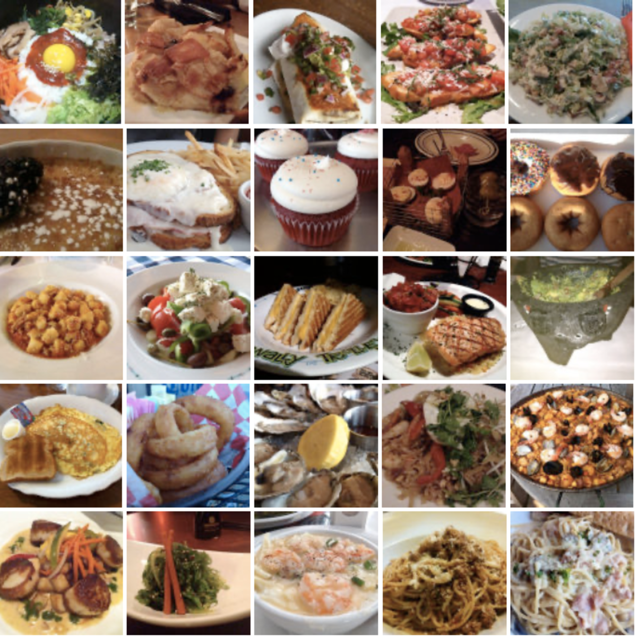
Dataset
Source: Kaggle — Recipe Ingredients Dataset Size:
~20,000+ recipes
50+ cuisine labels
Each sample contains ingredient list + cuisine label
Why this dataset?
Real-world data
Clean ingredient lists
Ideal for TF-IDF + classification

Slide 6
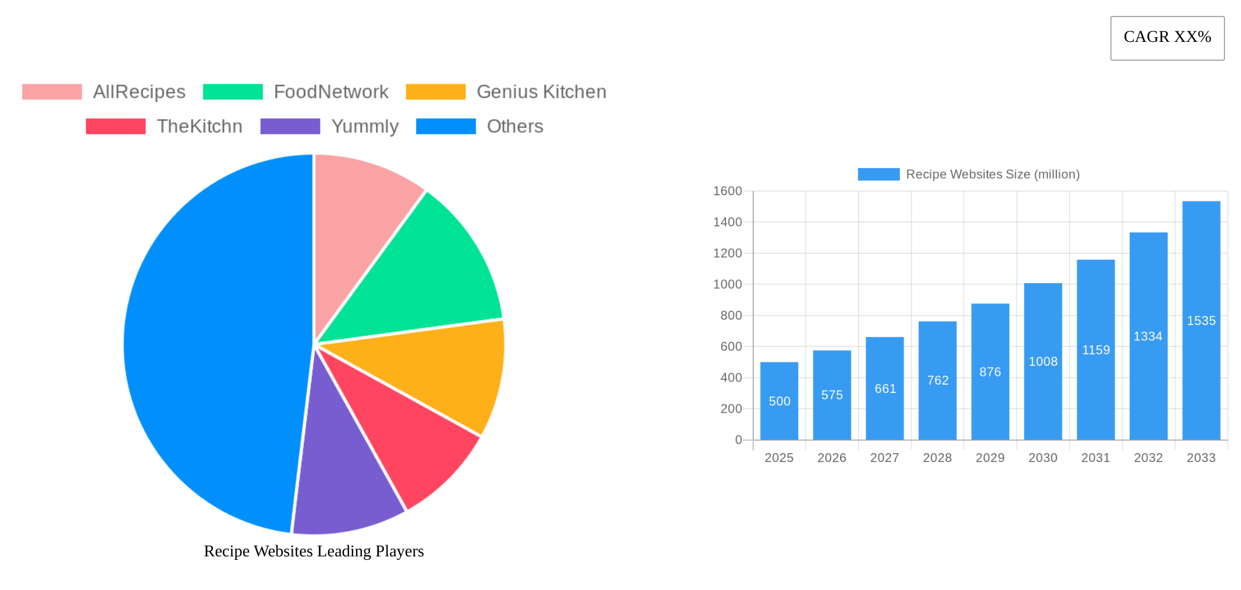
Literature Review / Similar Projects
Existing systems provide keyword search, not intelligent classification.
Many apps rely on manual tagging, not machine learning.
Few works provide ingredient-based cuisine prediction.
Most previous systems lack modern deployment pipelines (Docker + Cloud).

Slide 7
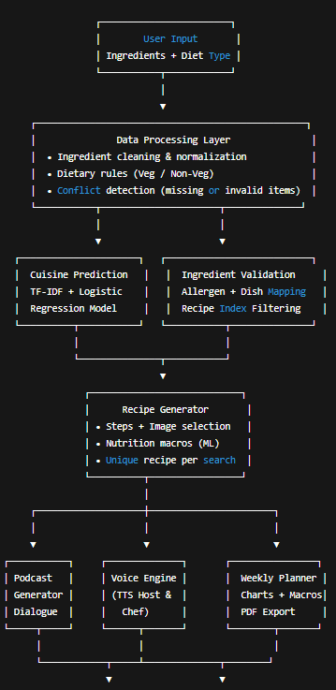
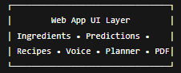
Model Building
Cleaned and normalized ingredients
Applied TF-IDF vectorization
Trained Logistic Regression classifier
Saved pipeline using joblib
Tuned vocabulary and parameters for higher accuracy
Strengths:
Fast
Lightweight
Deployment-friendly
High accuracy for sparse text

Slide 8
PREDICT Generate cuisine predictions from new ingredient lists using the trained TF–IDF + Logistic Regression model, returning the most likely cuisine and its confidence score. | ML task Supervised Machine Learning — multi-class text classification model. The system uses TF–IDF vectorization to transform recipe ingredients into numerical representations, and a Logistic Regression classifier to predict the cuisine category. | Value Propositions Instant recipe suggestions based on ingredients users already have Supports vegetarian and non-vegetarian modes Reduces food waste by maximizing ingredient usage Lightweight, fast, and explainable model suitable for real-time prediction User-friendly interface with clean, structured recipe cards | Data Sources Kaggle Recipe Ingredients Dataset Source: https://www.kaggle.com/datasets/kaggle/recipe-ingredients-dataset Size: ~180,000+ recipes Includes ingredients and cuisine labels Trained model saved as cuisine_pipeline.joblib | Collecting Data Load raw recipe data (ingredients + cuisine) Clean and normalize ingredient text Tokenize and build TF–IDF vectors Train Logistic Regression model Export trained model using joblib Store recipe metadata (title, steps, ingredients) in JSON structures
Making Predictions TF–IDF text representation of ingredients Normalized tokens (lowercased, unicode-normalized, cleaned) Ingredient coverage matching Protein-category detection (fish, chicken, beef, seafood, etc.) Vegetarian substitutions (soy milk, soy yogurt, plant-based equivalents) | Offline Evaluation Train a Logistic Regression classifier on TF–IDF features Perform train/test split and cross-validation Evaluate using accuracy and confusion matrix Save final model (joblib) Integrate ML predictions with rule-based logic for filtering and ranking Expose inference through a Streamlit application |  | Features Ingredients are transformed into high-dimensional TF–IDF vectors representing token-level importance across the dataset. This provides a quantitative and sparse representation suitable for linear classification models. | building Models Train a multinomial Logistic Regression classifier on the TF–IDF feature vectors. Hyperparameters tuned through experimentation, followed by full model training and export for deployment.
 | Live Evaluation and Monitoring Performance validated using a standard hold-out split and 10-fold cross-validation. Key evaluation metrics include accuracy, macro-F1 score, and confusion matrix analysis to assess class balance and generalization. Monitor live prediction behavior after deployment on Google Cloud Run, including response latency, request frequency, and prediction distribution across cuisines. Observe potential drift or misclassification patterns to inform future retraining.
The Machine Learning Canvas

Slide 9
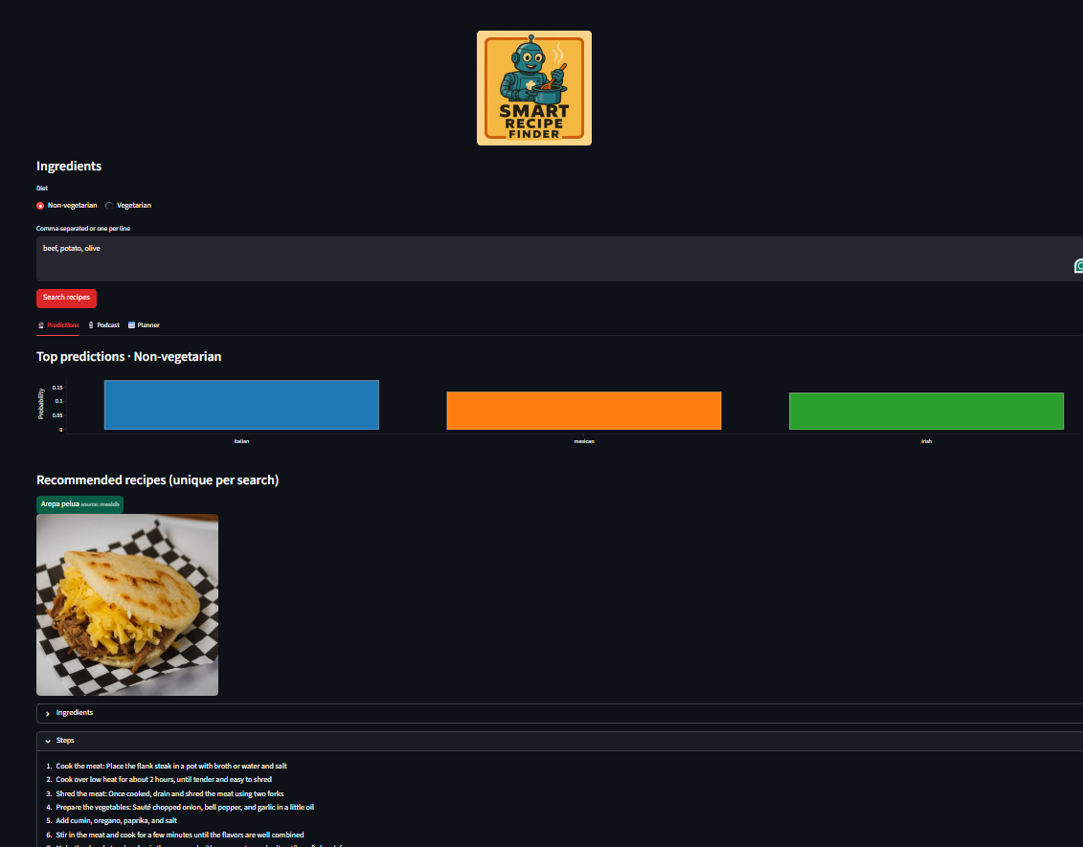
Deployment Pipeline
1. Convert notebook → Python script 2. Wrap model using FastAPI/Flask-like structure 3. Build Docker image:
Installed dependencies
Copied model + script
Exposed API port 4. Upload Docker image to Google Cloud Artifact Registry 5. Deploy via Cloud Run:
Auto-scaling
HTTPS endpoint
Public access enabled 6.Final deployed app: https://smart-recipe-app-249886303998.northamerica-northeast2.run.app/

Slide 10

Challenges & Issues
Docker environment conflicts
Missing dependencies inside container
Model path issues during deployment
Cloud Run CPU/memory constraints
Streamlit ↔ API request handling
Debugging failed builds
Ensuring local pipeline = cloud pipeline
How they were solved:
Rebuilt requirements
Clean Python environment
Isolated pipeline in a single script
Tested container locally before deployment
Used Google Cloud logs to debug

Slide 11

Conclusion & Recommendations
Built a complete end-to-end ML system
Used TF–IDF + Logistic Regression for cuisine classification
Trained, evaluated, and exported a reproducible ML pipeline
Containerized the app using Docker
Deployed the final API + UI on Google Cloud Run
Gained real experience debugging deployment issues
Project is fully live, scalable, and ready for future improvements

Slide 12
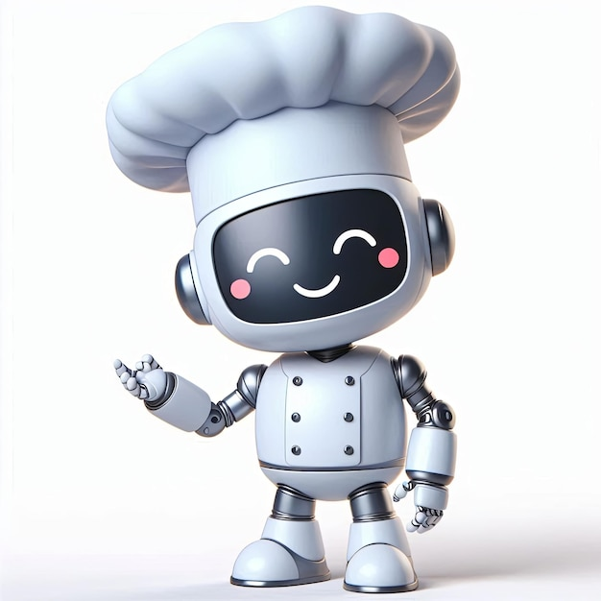
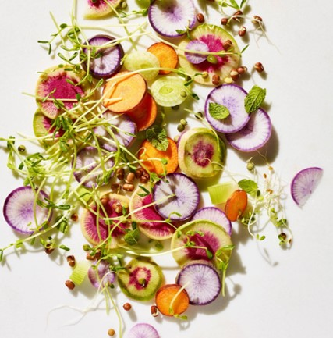
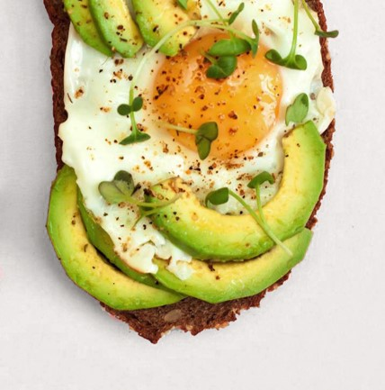
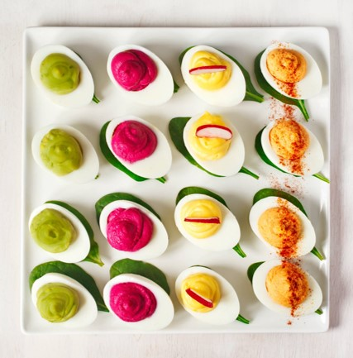
Thank you For your Attention !

